Slide 1
CO2301 - Games Development 1
Week 4
Finite State Machines + Maths
Gareth Bellaby

Slide 2
Practical
Finish game agents next week.
Check list of things to have completed in the worksheet for next week.
Keep your code - a good side project.

Slide 3
Part A:
Finite State Machines

Slide 4
Finite State Machines
A FSM is a machine which models states, transitions between states, and actions.
State Transition Diagram.

Slide 5
Convention being used
Box represents a state.
Line represents a transition between states, single-direction only.
An arrow with a dot at the end indicates the start state.
A state can just be an start state (nothing leads into the state).
A state can just be an end state (nothing leads from the state).

Slide 6
FPS Monster
Simple monster that reacts when the player comes into range and is in line-of-sight. Note different convention.
NPC hit points
Player location
Attacking
Attacks
No hit points
Idle
Start
Dying

Slide 7
FPS enemy
Start
See Enemy
Attack
Wander
No Enemy
Low Health
Flee
No Enemy
Taken from Intro to Game Development

Slide 8
UML
UML lends itself well to the design of a FSM.

Slide 9
Characteristics
Two type of machine:
Actions occur within a state
Actions occur during a transition
In the games industry the distinctions between the two types of FSMs are blurred.
It is common to see a FSM in which actions occur within a state and in which actions occur during a transition.

Slide 10
Simple Strategic RTS
Start
Resource Level
Build (middle game)
Numerical Inferiority
Explore (early game)
Numerical Superiority
Attack

Slide 11
Thief (approximately...)
Suspicious Sound/Sight
Suspicious Sound/Sight
Minor Sound
Suspicious
Definite Sound/Sight
Timer
Not alert
Definite Sound/Sight
Start
Fully
Alerted
Timer
Suspicious Sound/Sight

Slide 12
Your game
LOS and distance OR sound
LOS and distance OR sound
Move to thief
Out of range
Patrol
Reach waypoint
Start
Move to previous (?) waypoint

Slide 13
Your game
LOS and distance OR sound
LOS and distance OR sound
Move to thief
distance < 1
distance > 12
Patrol
Thief killed
Start

Slide 14
Capabilities
A game actor may have more than one FSM. One FMS could be swapped out and replaced by another.
A FSM could cause a cause in another FSM, e.g. a guard alerting another guard.
Probabilities
Randomness
Extra information
Extra actions

Slide 15
Characteristics of FSMs
To summarise, FSMs are:
Flexible
Appropriate
Comprehensible and straightforward
Can become unwieldy especially:
if FSM is piled upon FSM
lots of interconnecting FSMs (feedback)
Additions, special cases, etc. undermine the structure.

Slide 16
Part B:
Cross Product and derving a "look at" function

Slide 17
Note
Use lookAt function to point to next waypoint in sequence.
When you read the next waypoint increment waypoint number. If greater than max set back to 0.
Do not wait until you reach the waypoint!
Floating point inaccurancies mean that an equality test will most likely fail.
You will end up pointing at the waypoint (and hence point down, or with the model upside down).
Instead, check within a radius (N.B. a range)

Slide 18
Topics
Vectors and dot product
Test for "in front" or "behind".

Slide 19
Topic 1
Vectors and dot product

Slide 20
Relevance
You will have an exam for CO2301: Games Development 1 at the end of this semester.
You will be examined on the first half of the module.
All of the AI material is examinable.
However, so is all of the maths taught in this half of the module.
All of this lecture is examinable, including all of the equations.

Slide 21
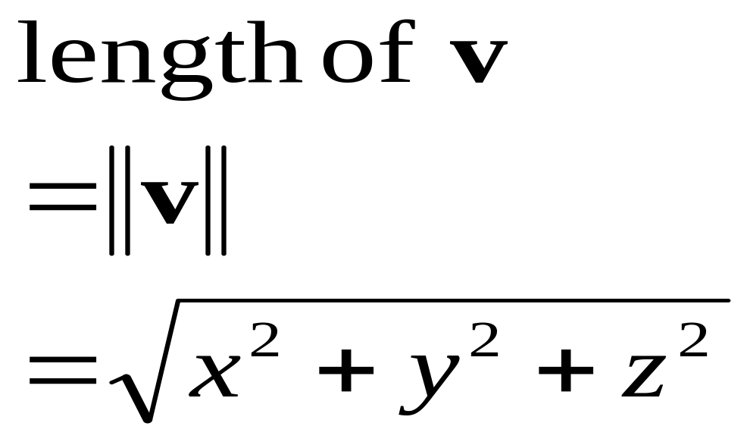
Length of a vector
The length of a vector can be calculated from its components.

Slide 22
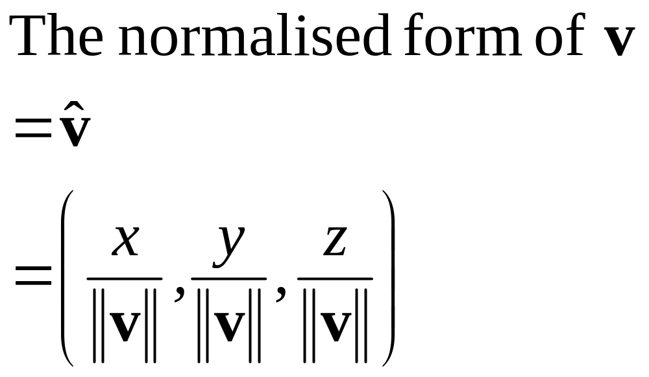
The normalised vector
A normalised vector is a vector whose length is 1.
Also known as the unit vector.
A vector is normalised by dividing each of its components by its length:

Slide 23


The dot product
The dot product gets its name from the symbol used: a single dot between two vectors.
Pronounced "V dot W", or say "the dot product of V and W".
The dot product takes two vectors and produces a single result.

Slide 24

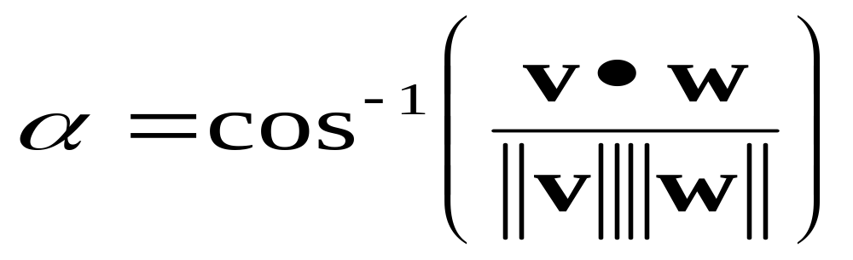
Cosine of the angle
The dot product expresses the relationship of the angle between two vectors.
Given any two vectors we can derive the angle between them.
The angle can be found using the inverse cosine operation (arcos)

Slide 25

Simplified if normalised
If v and w are normalised then the length of v is 1 and the length of w is 1.
The equation becomes:
(but only If v and w are normalised!)

Slide 26
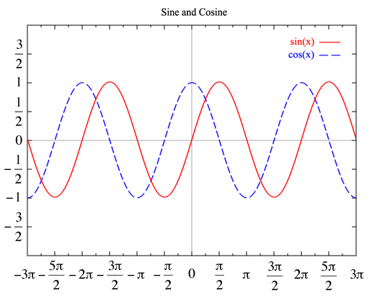
Cosine Wave
image of sine and cosine waves
Image taken from Wikipedia

Slide 27
Topic 2
Test for "in front" or "behind".

Slide 28
In front or behind?
You have a gun (or guard or whatever).
  Let the facing vector (the orientation) of the gun be v.
  Let the vector from the gun to the target be w.
Do not need to calculate the exact angle. Instead you can use the sign to classify angle
||a|| and ||b|| are always non-negative, so sign depends on cos a, therefore
  v • w > 0 if angle < 90°
  v • w = 0 if angle = 90° (orthogonal)
  v • w < 0 if angle > 90°

Slide 29
In front or behind?
Therefore if v • w < 0 then the target is behind the gun.
See Van Verth, also his web site.
For this particular test the length of the vectors doesn't matter so you don't have to normalise the vectors.
This makes this a very inexpensive test and so extremely useful.
Use it to test whether two vectors are orthogonal.

